Slide 1
Extraordinary in the Ordinary; Amazingness in the Dailyness Hebrews 13

Slide 2
“Therefore, since we are receiving a kingdom that cannot be shaken,
let us be thankful, and so worship God acceptably with reverence and awe, for our ‘God is a consuming fire.’”
Hebrews 12:28,29

Slide 3
“Keep on loving one another as brothers and sisters. Do not forget to show hospitality to strangers...Continue to remember those in prison ... Marriage should be honored by all... Keep your lives free from the love of money...”
Hebrews 13:1-3

Slide 4
THE WAY “Keep on loving one another as brothers and sisters.” Hebrews 13:1

Slide 5
“Jesus replied: ‘Love the Lord your God with all your heart and with all your soul and with all your mind.’ This is the first and greatest commandment. And the second is like it: ‘Love your neighbor as yourself.’ All the Law and the Prophets hang on these two commandments.” Matt. 22:37-40

Slide 6
“Jesus said: ‘A new command I give you: Love one another. As I have loved you, so you must love one another. By this everyone will know that you are my disciples, if you love one another.’” John 13:34,35

Slide 7
THE WAY “Keep on loving one another as brothers and sisters.” Hebrews 13:1

Slide 8
We love because He first loved us. 1 John 4:19 Forgive as the Lord forgave you. Colossians 3:13

Slide 9
“Do not forget to show hospitality to strangers, for by so doing some people have shown hospitality to angels without knowing it. 13:2

Slide 11
“Do not forget to show hospitality to strangers, for by so doing some people have shown hospitality to angels without knowing it.” Hebrews 13:2

Slide 12
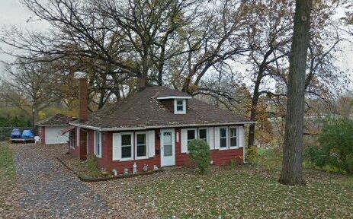

Slide 13
“Do not forget to show hospitality to strangers, for by so doing some people have shown hospitality to angels without knowing it.” Hebrews 13:2

Slide 14
“Continue to remember those in prison as if you were together with them in prison, and those who are mistreated as if you yourselves were suffering.” Hebrews 13:3

Slide 15
“The King will reply, ‘Truly I tell you, whatever you did for one of the least of these brothers and sisters of mine, you did for me.’” Matthew 25:37-40

Slide 16
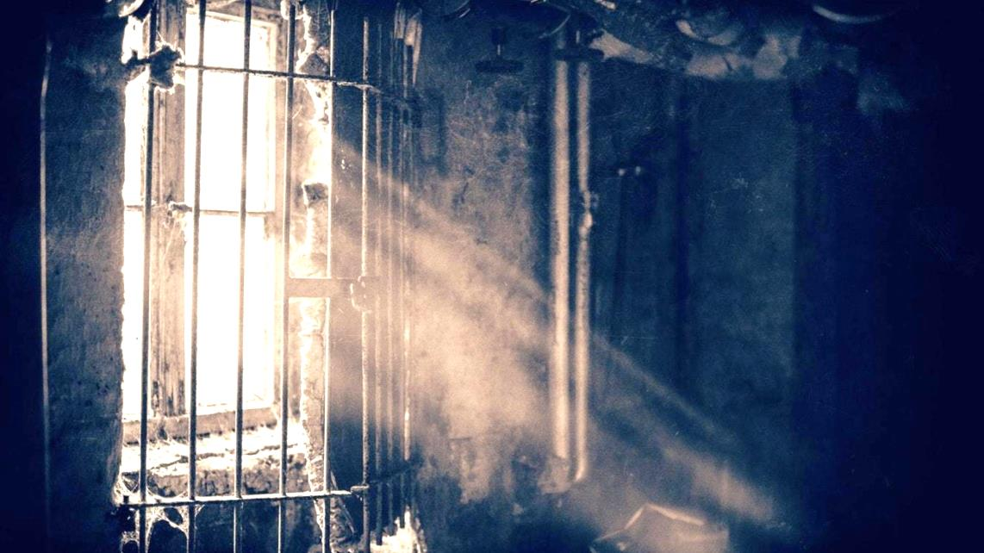
“Continue to remember those in prison as if you were together with them in prison, and those who are mistreated as if you yourselves were suffering.” Heb. 13:3

Slide 17
“If they hear that any of their number is imprisoned or oppressed for the name of their Messiah, all of them provide for his needs, and if it is possible that he may be delivered, they deliver him. If there is among them a man that is poor or needy, and they have not an abundance of necessaries, they fast two or three days that they may supply the needy with the necessary food.” - Aristides

Slide 18
“Marriage should be honored by all, and the marriage bed kept pure, for God will judge the adulterer and all the sexually immoral.” Hebrews 13:4

Slide 19
“Marriage should be honored by all, and the marriage bed kept pure, for God will judge the adulterer and all the sexually immoral.” Hebrews 13:4 (See 1 Corinthians 6:9-11)

Slide 20
Woman at the Well - John 4 Woman caught in adultery - John 8 Tax collectors, prostitutes - Luke 15 King David - 2 Samuel 11 Psalm 32, 51

Slide 21
“Remember, God is the one who sits on the throne – not the best-selling author or the most popular talk show host or the biggest box office star. Majority opinion may rule in America, but God rules heaven and earth. He has the power to veto any opinion – no matter how popular, no matter how prevailing.” - Charles Swindoll

Slide 22
“Keep your lives free from the love of money and be content with what you have.” Hebrews 13:5

Slide 23
“No one can serve two masters. Either you will hate the one and love the other, or you will be devoted to the one and despise the other. You cannot serve both God and money.” Luke 16:13

Slide 24
...because God has said, “Never will I leave you; never will I forsake you.” So we say with confidence, “The Lord is my helper; I will not be afraid. What can mere mortals do to me?” Hebrews 13:5,6

Slide 25
The TRUTH (Leadership) “Remember your leaders, who spoke the word of God to you. Consider the outcome of their way of life and imitate their faith.” Hebrews 13:7

Slide 26
“Remember your leaders, who spoke the word of God to you. Consider the outcome of their way of life and imitate their faith.” Hebrews 13:7 - Speaking the word of God - Living a life of faith

Slide 27
“Obey your leaders and submit to them—for they keep watch over your souls as those who will give an account—so that they may do this with joy, not groaning; for this would be unhelpful for you.” Hebrews 13:17

Slide 28
“Obey your leaders and submit to them—for they keep watch over your souls as those who will give an account—so that they may do this with joy, not groaning; for this would be unhelpful for you.” Hebrews 13:17 - Loving concern for others - Accountable to God

Slide 29
“Pray for us. We trust that we have a clear conscience and desire to live honorably in every way. I particularly urge you to pray so that I may be restored to you soon." 13:18,19

Slide 30
“Pray for us. We trust that we have a clear conscience and desire to live honorably in every way. I particularly urge you to pray so that I may be restored to you soon." 13:18,19 - Living with purity, integrity and honor; humility, love...

Slide 31
(Leadership) - Speaking the word of God - Living a life of faith - Loving concern for others - Accountable to God - Living with purity, integrity and honor; humility, love...

Slide 32
Doctrine: “Do not be carried away by all kinds of strange teachings. It is good for our hearts to be strengthened by grace, not by eating ceremonial foods, which is of no benefit to those who do so.” Hebrews 13:9

Slide 33
Doctrine: “Do not be carried away by all kinds of strange teachings. It is good for our hearts to be strengthened by grace, not by eating ceremonial foods, which is of no benefit to those who do so.” Hebrews 13:9 - We are strengthen by His grace

Slide 34
“Therefore do not let anyone judge you by what you eat or drink, or with regard to a religious festival, a New Moon celebration or a Sabbath day. These are a shadow of the things that were to come; the reality, however, is found in Christ...” Colossians 2:16-17

Slide 35
“And if by grace, then it cannot be based on works; if it were, grace would no longer be grace.” Romans 11:6

Slide 36
“Through Jesus, therefore, let us continually offer to God a sacrifice of praise—the fruit of lips that openly profess his name. And do not forget to do good and to share with others, for with such sacrifices God is pleased.” Hebrews 13:15,16 - Praise His Name and share His love.

Slide 37
Romans 12:1 “Therefore, I urge you, brothers and sisters, in view of God’s mercy, to offer your bodies as a living sacrifice, holy and pleasing to God—this is your true and proper worship.”

Slide 38
The LIFE “Now may the God of peace, who through the blood of the eternal covenant brought back from the dead our Lord Jesus, that great Shepherd of the sheep, equip you with everything good for doing his will, and may he work in us what is pleasing to him, through Jesus Christ, to whom be glory for ever and ever. Amen.” 3:20,21

Slide 39
The LIFE “Now may the God of peace, who through the blood of the eternal covenant brought back from the dead our Lord Jesus, that great Shepherd of the sheep, equip you with everything good for doing his will, and may he work in us what is pleasing to him, through Jesus Christ, to whom be glory for ever and ever. Amen.” 3:20,21

Slide 40
The LIFE “Now may the God of peace, who through the blood of the eternal covenant brought back from the dead our Lord Jesus, that great Shepherd of the sheep, equip you with everything good for doing his will, and may he work in us what is pleasing to him, through Jesus Christ, to whom be glory for ever and ever. Amen.” 3:20,21

Slide 41
The LIFE “Now may the God of peace, who through the blood of the eternal covenant brought back from the dead our Lord Jesus, that great Shepherd of the sheep, equip you with everything good for doing his will, and may he work in us what is pleasing to him, through Jesus Christ, to whom be glory for ever and ever. Amen.” 3:20,21

Slide 42
“His divine power has given us everything we need for a godly life.” 2 Peter 1:3 “Now to him who is able to do immeasurably more than all we ask or imagine, according to his power that is at work within us.” Ephesians 3:20

